Slide 1
Unit – II Opportunity and Customer Analysis

Slide 2
Determining Your Entrepreneur Style
As a business owner or business professional there is great value in understanding our entrepreneurial style.
We are all unique. We have natural strengths and weaknesses. We have experience and knowledge gained over the years.
When we do we can put ourselves in situations that suit our natural entrepreneurial style. We can be more successful with less effort.
Decisions become easier and more natural. Activities become more enjoyable. Work becomes a pleasure. Confidence builds and radiates.
It also allows us to identify roles and activities that are not natural for us. In these situations we can find partners or suppliers with complimentary strengths.
Entrepreneurs are leaders who can see into the future with inspired vision, championing highly competent teams to make the seemingly impossible possible.

Slide 3
The Eight Entrepreneurial Style Profiles
Fore each profile there are identifiable role models who have made their fortunes by applying their innate entrepreneurial style and approach to a suitable business model.
CREATOR | Create a better product | Bill Gates, Steve Jobs,
STAR | Create a Unique Brand | Oprah Winfrey, Martha Stewart,
SUPPORTER | Leading the Team | Jack Welch, Meg Whitman
DEAL MAKER | Bringing People Together | Donald Trump, Rupert Murdoch
TRADER | Buying Low, Selling High | George Soros, John Templeton
ACCUMULATOR | Collecting Appreciating Assets | Warren Buffet, Paul Allen
LORD | Controlling Cash Generating Assets | Andrew Carnegie, Sergey Brin
MECHANIC | Creating a Better System | Henry Ford, Ingvar Kamprad (IKEA), Michael Dell

Slide 4
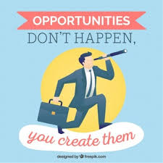
Identify More Business Opportunities
To be successful entrepreneurs, we need to be continually innovating and looking for opportunities to grow our startups.
Four ways to identify more business opportunities.
Listen to the Potential Clients
Listen to the Customers
Look at the Competitors
Look at Industry Trends
and Insights

Slide 5
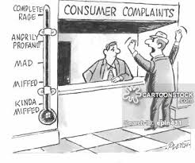
Listen to the Potential Clients
When targeting potential customers listen to their needs, wants, challenges and frustrations with the industry.
Have they used similar products and services before?
What did they like and dislike?
Why did they come to us?
What are their objections to
our products or services?
This will help us to find opportunities to develop more tailored products and services, hone your target market and identify and overcome common objections.

Slide 6
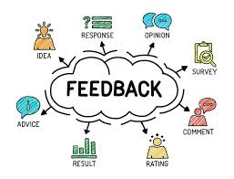
2. Listen to the Customers
When talking to the customers listen to what they saying about the industry, products and services.
What are their frequently asked questions?
What are their Experiences?
What are their Frustrations?
What are their Feedback
and complaints?
This valuable customer information will help identify key business opportunities to expand and develop current products and services.

Slide 7
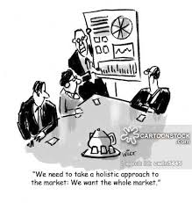
3. Look at the Competitors
A little competitive analysis is done to see what other startups are doing, and more importantly, not doing?
Where are they falling down?
Are they doing right?
What makes customers go
to them over you?
Analyzing the competitors will help you identify key business opportunities to expand your market reach and develop your products and services.

Slide 8
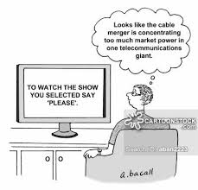
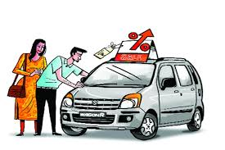
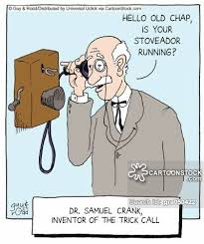
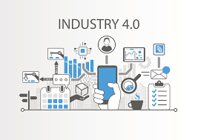


4. Look at Industry Trends and Insights
Industry publications, join relevant associations, set Google alerts for key industry terms and news and follow other industry experts on social media.
Closely absorb in the industry and continually educate yourself on the latest techniques and trends.

Slide 9
Methods Of Finding and Understanding Customer Problems
How do Entrepreneurs learn what my customer really needs or wants?
There are many traditional methods of obtaining data about customers such as surveys, focus groups, interviews, and secondary research.
These methods are very effective and in the right situations can provide insights about customers that inform business models and organization designs.

Slide 10
Direct observations of a potential customer’s activities will provide those insights.
Some companies (developing apps) use a “test and learn” method of releasing a beta version of their app to see how customers use it and gather direct customer feedback.
Over a period of time, refinements are made to the app until is it considered ready or out of beta testing.
Sometimes at this point, the developer shifts from a free app to a for purchase app because they have discovered most of their customers needs and wants and have now met them.

Slide 11
2. How do we design business model to give customers what they want?
We deliver those services or products in a distinctive way. This is as important or even more important than knowing what customers wanted in the first place.
Unfortunately, many companies struggle to deliver because they fail to change how they operate.
EXAMPLE : A client who set up a large standardized back office to facilitate customer/vendor billing.
Although the support services were very efficient and met internal productivity requirements, they proved difficult for customers to navigate and ultimately drove customers away.
The result was very happy internal users but frustrated external customers.
Instead of structuring the organization to better deliver services to customers, the company was distracted by the internal operational ease.

Slide 12
To avoid this, ensure that the business model is a reflection of the key customer problem(s) plan solve.
Then, we must align work activities, reward systems, metrics, culture, and structures to the strategy and business model.
This alignment approach is not a quick shuffling of the organization chart, but it is a thoughtful (and in some cases, ongoing) effort to holistically align the entire organization and the related processes, systems, structures, metrics, rewards, and talent.

Slide 13
Design Thinking
The dynamic concept of ‘design thinking’ that fully caters to the user-oriented, prototype-centered process of innovation ideally suited for product, service and business design.
Design thinking is a systematic approach to handling problems and generating new opportunities. The concept is pertinent to any field and purpose.
To build a new product or customer experience or even take the business to the next level, this approach touches everywhere.
It is seen that the design principles contribute significantly in elevating the success rate for innovation.
Even the design-centric firms like Apple, IBM, Coca-Cola have delivered extraordinary performance in the last 10 years by achieving 219% in S&P 500

Slide 14
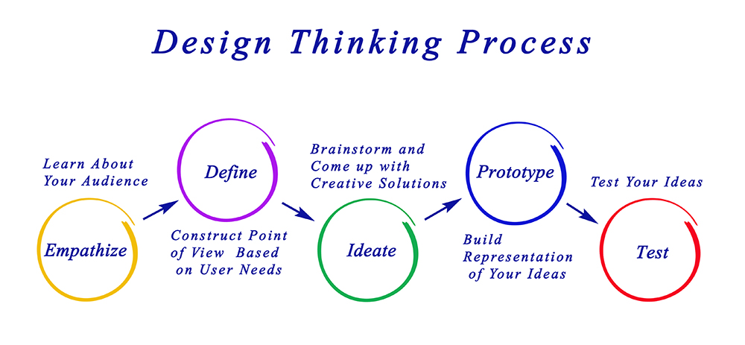
Process of Design Thinking

Slide 15
Let us distinguish the design thinking process with the usual innovation process. The regular innovation process consists of four stages – Ideate, Define, Design and Develop.
These stages have to be synced efficiently so as to foster innovation in an organization. On the other hand, design thinking process has five stages-
Empathize
1
Define
Five Stages of Design Thinking Process
Test
2
5
Ideate
Prototype
3
4

Slide 16
Empathize:
Empathizing is central to the design thinking process.
It highlights the significance of listening to the requirements and wants of our customers relative to the particular problem.
The approach aids us in saving our discoveries and learning's during this stage in a systematic way such as empathy maps.
2. Define
Here we combine all the insights collected at the time of listening and observing people. That means we start to define a problem.
An aspect that design thinking proves vital at is framing a problem in a clear manner so that we end up devising solutions and exploring opportunities.

Slide 17
3. Ideate
So, now as the problem or the opportunity is clearly framed, we can search for methods to handle it. We should spur as many ideas as possible. Yes, we brainstorm or ideate.
Design thinking stresses that during this phase we shouldn’t ignore ideas that seem obvious or easy. Any idea can sprout a brilliant concept.
4. Prototype
Prototyping brings the solutions into vision. Different methods are involved in it such as sketching, rapid prototyping and many others.
No matter whatever method you opt, the core purpose of this stage remains the same, that is, we intend to create rough drafts of solutions to decide if these will prove beneficial for the problem.
5. Test
In this stage, we test our prototype with the customers so as to monitor the response and deem whether the solution satisfied them or not.

Slide 18
The Power of Design Thinking
Thinking in design empowers the designers to create the right features for the right people.
It ensures that designers deal with real user problems and thus avoid creating something that is undesirable.
Design thinking gives the edge to pass the right decisions when it comes to forming features.
The concept allows the designers to pose right questions, create right features and engage with the clients effectively.
They can do the calculation as to whether a particular feature will fit in the product or not or if it will serve a real user problem?

Slide 19
Identify Potential Problems, Customer Segmentation and Targeting
Targeting, or “segmenting” these people means you’ll be able to build, efficiently using your resources to impress and attract your potential customers.
First, figure out the need for your product or service, focusing on what problem it can solve.
Then refine your target market by identifying who has bought your product or service already.
This includes target demographics, audience type, and any other attributes about your target customer segment.
If your product or service is brand new, a good alternative might be looking at your competitors to get additional insights.

Slide 20
How to Identify and Analyze the Target Market
What are the features of your business, products or services?
What are the benefits of these features?
How do the benefits help the user?
How does your target market shop?
What is the typical age and gender of your target market?
What is their average income and education?
What are their common interests? These can include attitudes, values and lifestyle.
Is your target market comfortable with online?
What are the web and offline marketing methods engage them?

Slide 21
1. Gather Information.
Some of the business questions you’ll be addressing include:
Is the potential market for your product or service large enough?
Do you need to alter your business idea to best appeal to this audience?
Should you tailor your product or service in some way to maximize effectiveness?
How can you target your marketing efforts to optimize reach with the most promising potential buyers?

Slide 22
2. Create Customer Profiles and Market Segments. Those consumers who find your product or service appealing often share similar characteristics.
Demographic criteria will include:
Age, Gender ,Location
Education level, Income level
Marital or family status, Occupation
Ethnic background
Psychographic Criteria : Goes a little deeper, painting a more complete picture of your audience:
Interests, Hobbies
Values, Attitudes
Behaviors, Lifestyle preferences
Every industry, business and product is different, so these lists are by no means the end-all-be-all — more of a starting point to evaluate market segment size and opportunity.

Slide 23
3. Be specific.
Narrowly defining your target customer is more of an art than a science. Try to be as specific as possible.
In reality, identifying a specific target audience helps ensure that you make decisions that are dictated by your customers, which sets you up for long-term success.
Drill down to the audience truly their attitudes, Beliefs and Pain points
Understanding their age and income is the first step, but drilling down to the core customer problem is what will help set your products — and brand — apart from the competition.
4. Tap existing resources.
Doing a quick search online, will often find existing resources that can help pull together information about the industry, the market segment, the competition and the ideal potential customer.

Slide 24
5. Look at your competition.
What’s their market positioning?
What are customers actually purchasing from them?
How about their pricing?
What are their customers willing to pay?
Would they pay more if you offered something extra?
What are customers saying on social media?
What social media channels are they interacting with the most?
What other interests do they list on their personal social media pages?
6. Conduct your own primary research.
It involves gathering data directly from consumers.
Focus groups: Get feedback from a small group of consumers who fit your ideal customer profile via Q&A sessions and group discussions.

Slide 25
7. Business in a fresh light.
Do you feel there are enough potential customers within your target audience to start a brand new business?
Will your target market benefit from your product or service?
Will this target market see a true need for it? Will they come back repeatedly to purchase?
Do you understand what drives your target market to make buying decisions?
Can your target market afford your product or service? If so, how frequently can they buy?
Answering these questions will help understand if we are truly ready to jump into business to appeal to a different market

Slide 26
Consumer Adoption Process
Philip Kotler considers five steps in consumer adoption process, such as
On the other hand, William Stanton considers six steps, such as
Philip Kotler
Awareness
Interest
Evaluation
Trial
Adoption
William Stanton
Awareness Stage,
Interest and Information Stage,
Evaluation Stage,
Trial Stage,
Adoption Stage,
Post-adoption Stage

Slide 27
1. Awareness Stage:
Individual consumer becomes aware of the innovation. He is exposed to innovation but knows very little regarding the innovation.
He has only limited information about it. He is aware of either by discussion with friends, relatives, salesmen, or dealers.
He gets idea about a new product from various means of advertising like newspapers, magazines, Internet, television, outdoor media, etc.
At this stage, he doesn’t give much attention to the new product.
2. Interest and Information Stage:
In this stage, the consumer becomes interested in innovation and tries to collect more information.
He collects information from advertising media, salesmen, dealers, current users, or directly from company.
He tries to know about qualities, features, functions, risk, producers, brand, color, shape, price, incentives, availability, services, and other relevant aspects.
Simply, he collects as much information as he can.

Slide 28
3. Evaluation Stage:
Now, accumulated information is used to evaluate the innovation.
The consumer considers all the significant aspects to judge the worth of innovation.
He compares different aspects of innovation like qualities, features, performance, price, after-sales services, etc., with the existing products to arrive at the decision whether the innovation should be tried out.
4. Trial Stage:
Consumer is ready to try or test the new product. He practically examines it.
He tries out the innovation in a small scale to get self-experience.
He can buy the product, or can use free samples.
This is an important stage as it determines whether to buy it.

Slide 29
5. Adoption Stage:
If trial produces satisfactory results, finally the consumer decides to adopt or buy the innovation.
He decides on quantity, type, model, dealer, payment, and other issues.
He purchases the product and consumes individually or jointly with other members.
6. Post Adoption Behavior Stage:
This is the last stage of consumer adoption.
If a consumer satisfies with a new product and related services, he continues buying it frequently, and vice-versa.
He becomes a regular user of innovation and also talks favorable to others. This is a crucial step for a marketer.

Slide 30
Value Proposition
A value proposition defines the benefits your company's products and services offer to the customer.
This short statement, based on your Business Concept Statement, should express the essence of your business in a way that compels the customer to buy.
It's important to expend the necessary time and effort to craft a compelling value proposition since it will form the basis for all your sales, marketing, and product development efforts.
The value proposition is also part of your Business Plan.
A value proposition is a valuable tool to guide your marketing efforts.

Slide 31
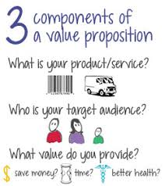
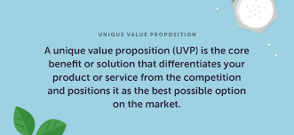

Slide 32
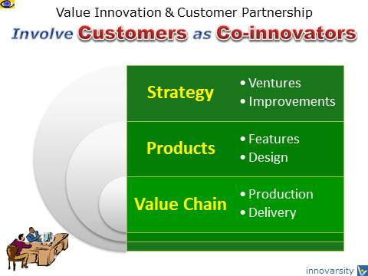
Benefits of Value Proposition:
Creates a strong differentiation between you and your competitors.
Increase not only the quantity but also the quality of prospective leads.
Gain market share in your targeted segments.
Improves your operation efficiency.
Increases your revenue.
Ensures that everyone in your company communicates the same message.

Slide 33
Guidelines To Create A Value Proposition
Use the Business Concept Statement as a starting point for expressing the value proposition.
Address the needs of your target market. What problems do your target customers need to solve? What's not working for them? Where do they want to go?
Emphasize benefits, not features.
Don't explain what the technology does; explain what the buyer will get out of using the technology. Some examples of benefits are greater revenue opportunity, a competitive advantage, reduced costs and expenses, greater convenience, greater Return on Investment (ROI), and better results.
Use tangible examples. Be as precise and specific as possible. Include numbers, percentages, and time frames.
Differentiate yourself from the competition. What do you have that no one else has? And-most importantly-how is this an advantage to your customers? Research and test your value proposition.

Slide 34
Customer Driven Innovation
Customer Driven Innovation means customers looking forward for more innovative product and service , so you have to develop your company to satisfy customers needs.
But customer driven influence means customers looking forward for brand names and more promoted goods and service in markets .
Shifting to consumer-driven innovation
Innovation is about businesses trying to keep up with consumer expectations faster than the competition.
Customers no longer think about brands within the confines of the industry they operate on.
When it comes to customer service we don’t just compare a brand to its direct competitors, but to the best customer service we receive from anywhere.
Ex: We get frustrated when an airline is unresponsive on social media because our broadband provider responds in under 10 minutes.

Slide 35

TEN KEYS OF VALUE INNOVATION
35
Customer Insight
Beta Testing
Customer Involvement
Continuous Improvement
Customer Feedback
Strategic Intent
Customer Focus
Observing people
Customer Empathy
Competitive Intelligence

Slide 36
Seven Practice Tips For Customer - Driven Innovation
Observe People to understand hidden and unarticulated customer needs.
Empathize with your customers, live their life, "walk a mile in the shoes of your customer".
Involve Everyone, require every person, regardless of their position, to spend time on customer contact and services activities.
Involve Customers in testing the prototype of your new product.
Help Your Employees to understand the customer's needs by involving them in listening to customer feedback after a new product launch.
Watch How The Customers Use Your Product to learn what works and what doesn't work.
Ingrain customer-driven innovation in your corporate culture and operations of your company.

Slide 37
Drivers of Innovation
Coming up with new ideas for products and services
Listening to customers
Continuous efforts to improve current products
Offering a unique product
Excellent customer service
What makes a Company Innovative

Slide 38
Few Examples of Customer Driven Innovations
Amazon.com: With the vision statement as “We seek to become Earth’s most customer centric company”,
Sony: They have over 5,300 customer service locations across the globe
Netflix : Netflix collects a huge amount of data on customers to create hyper-personalized recommendations.
Dollar Shave Club: There is a lot of competition in the subscription beauty industry, but Dollar Shave Club stands out because of its focus on customers. “We don’t respond to situations; we respond to people”.

Slide 39
Never underestimate your Clients' Complaint, no matter how funny it might be!
This is a real story that happened between the customer of General Motors and its Customer-Care Executive. A complaint was received by the Pontiac Division of General Motors: This is the second time I have written to you, and I don't blame you for not answering me, because I sounded crazy, but it is a fact that we have a tradition in our family of Ice-Cream for dessert after dinner each night.

Slide 40
But the kind of ice cream varies so, every night, after we've eaten the whole family votes on which kind of ice cream we should have and I drive down to the store to get it. It's also a fact that I recently purchased a new Pontiac and since then my trips to the store have created a problem. You see, every time I buy a vanilla ice-cream, when I start back from the store my car won't start. If I get any other kind of ice cream, the car starts just fine. I want you to know I'm serious about this question, no matter how silly it sounds: "What is there about a Pontiac that makes it not start when I get vanilla ice cream, and easy to start whenever I get any other kind?"

Slide 41
The Pontiac President was understandably skeptical about the letter, but sent an Engineer to check it out anyway.
The latter was surprised to be greeted by a successful, obviously well educated man in a fine neighborhood.
He had arranged to meet the man just after dinnertime, so the two hopped into the car and drove to the ice cream store.
It was vanilla ice cream that night and, sure enough, after they came back to the car, it wouldn't start. The Engineer returned for three more nights. The first night, they got chocolate.
The car started. The second night, he got strawberry. The car started. The third night he ordered vanilla. The car failed to start.

Slide 42
Now the Engineer, being a logical man, refused to believe that this man's car was allergic to vanilla ice cream. He arranged, therefore, to continue his visits for as long as it took to solve the problem.
And toward this end he began to take notes: he jotted down all sorts of data: time of day, type of gas uses, time to drive back and forth etc.
In a short time, he had a clue: the man took less time to buy vanilla than any other flavor. Why? The answer was in the layout of the store. Vanilla, being the most popular flavor, was in a separate case at the front of the store for quick pickup.
All the other flavors were kept in the back of the store at a different counter where it took considerably longer to check out the flavor.
Now, the question for the Engineer was why the car wouldn't start when it took less time.

Slide 43
Eureka - Time was now the problem - not the vanilla ice cream!!!! The engineer quickly came up with the answer: "vapor lock".
It was happening every night; but the extra time taken to get the other flavors allowed the engine to cool down sufficiently to start.
When the man got vanilla, the engine was still too hot for the vapor lock to dissipate.

Slide 44
Remember
Even crazy looking problems are sometimes real and all problems seem to be simple only when we find the solution with cool thinking.
Don't just say its "IMPOSSIBLE" without putting a sincere effort... Observe the word "IMPOSSIBLE" carefully... Looking closer you will see, "I' M POSSIBLE"... “What really matters is your attitude and your perception”.

